Slide 1
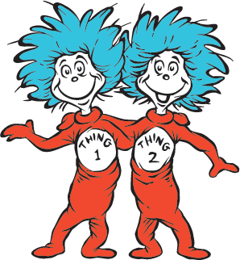
MRS. PEACOCK’S
WEEK OF: February 26- March 1, 2024
Weekly Skills
Coming up @ NSE
ELA: Describe Connections between historical events
PHONICS: OO, OU, U
MATH: Add several 2-digit numbers
LANGUAGE: Pronouns
Social Studies: Maps
2/29- PARENT LITERACY NIGHT @ NSE
2/26- CAT IN THE HAT DAY
2/27- FOX IN SOCKS DAY
2/28- RED FISH, BLUE FISH DAY
2/29- GREEN EGGS & HAM DAY
3/1- READ ACROSS AMERICA DAY
3/4- SPRING PICTURES
3/8- SUPER HERO DAY
3/11-3/15- SPRING BREAK
PHONICS Skill OF THE WEEK
should
cook
pull
nook
footprint
pushing
full
bookstore
wouldn’t
hook
could
book
push
done
stood
upon
almost
good
bushes
above
VOCABULARY
**vocab test will be 3/8**
1.) solved –how a problem is worked out
2.) point of view- how a character thinks or feels about other story characters or events
3.) supports- to agree with or help explain
4.) speaker- the voice or one that speaks in a story
5.) problem- a state of difficulty that needs to be resolved
YEARBOOKS ARE ON SALE
THROUGH FEB. 29TH!
Homework- Reading , Math, and Facts
Tests- math facts and Spelling on Friday
Spring Music Program-
Our program date is April 4th!

